Slide 1

ALY 6060​ Decision Support & Business Intelligence
Prof. Susan Gracia
A Guide to Embedded Analytics & Business Intelligence
Sunil Raj THOTA NUID: 001099670

Slide 2
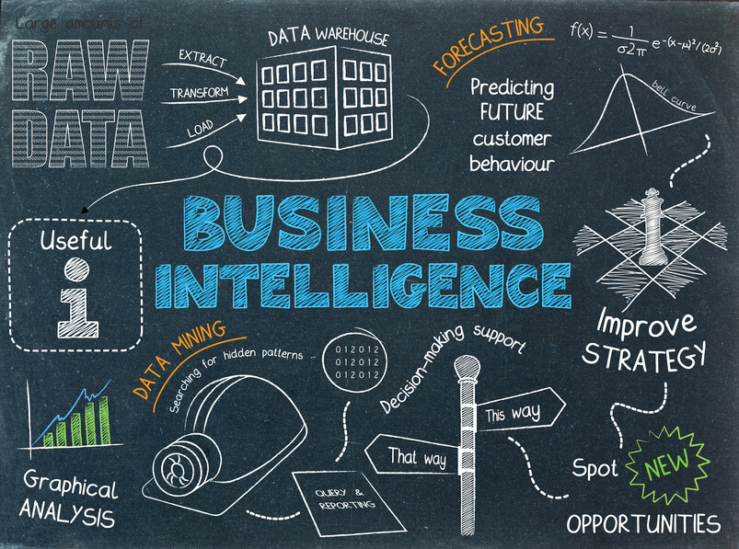
[1] Prince Patni (June 2020), What is Business Intelligence? The A to Z BI Glossary is here ! BI Blog https://princepatni.com/blog/tech/what-is-business-intelligence/
Business Intelligence – The Big Picture
Notes:
It brings together business analytics, data mining, data visualization, data tools and infrastructure, and best practices to help companies make better data-driven decisions.
Modern BI is defined as having a full perspective of your organization's data and using that data to drive change, eliminate inefficiencies, and quickly adjust to market or supply changes.

Slide 3
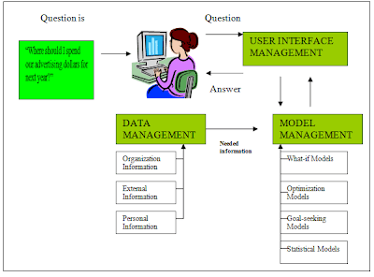
[2] Decision support system (Jan 2010), Components of Decision Support Systems Blogspot http://dsssystem.blogspot.com/2010/01/components-of-decision-support-systems.html
Decision Support Systems
Adaptability and flexibility.
High level of Interactivity.
Ease of use.
Efficiency and effectiveness.
Complete control by decision-makers.
Ease of development.
Extendibility.
Support for modeling and analysis.
Notes:
Decision support systems come in a wide range of applications and levels of complexity, but they always share some common characteristics.
Data management, model management, knowledge management, and user interface management are the four components of a typical Decision Support System.

Slide 4











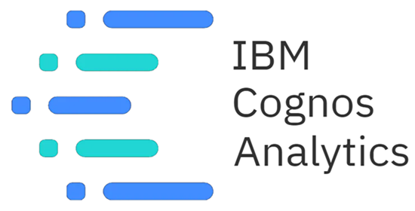
Decision Support Systems & Business Intelligence – Tools & Skills
Business Acumen
SQL
Python
R
Reporting
Data Warehousing
ETL
OLAP/ OLTP
Strategic
Analytical
Communication
Design Thinking
Data Governance
Data Visualization
MicroStrategy Looker MS Excel
Tableau Power BI SAS
Datapine Zoho Analytics DOMO
IBM Cognos Analytics Qlik Sense SISENSE

Slide 5
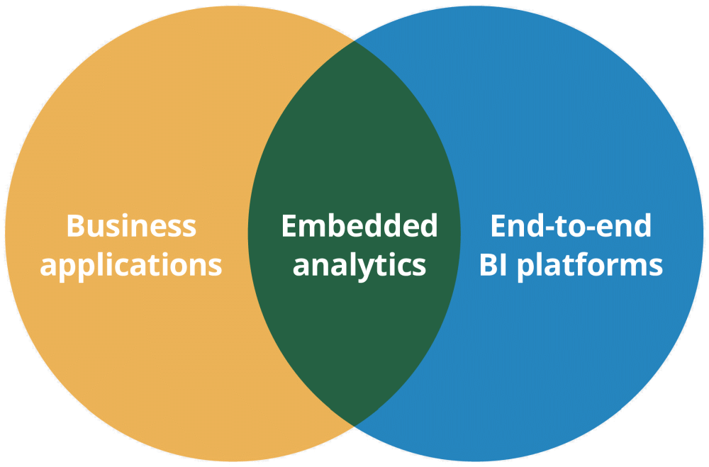
The World of Embedded Analytics
Embedded analytics software enable self-service access to information
Focuses more on the user experience
Evidenced by intuitive dashboards and visual reports
The future of embedded analytics is very optimistic
Integrated to other apps hence enabling businesses meet their goals and needs
AI will lead to more powerful applications - Predictive Analysis
[3] LogiAnaltics What is Embedded Analytics? Definitive guide to embedded, https://www.logianalytics.com/definitiveguidetoembedded/what-is-embedded-analytics/

Slide 6



Data Analytics vs Web Analytics
It is the process of gathering, measuring, reporting, and analyzing online data
To better understand and optimize web pages
It covers online traffic measurements to market research to determine the effectiveness of the website
It assists users in developing KPIs and formulating an online strategy
Conducting experiments to test UI modifications
The science of analyzing raw data is known as Data Analytics
It obtain insights and searches for significant relationships
Help organizations and businesses make better decisions
To validate, measure, and reject existing ideas/ models
Inferences made based on the emphasis of data analytics

Slide 7
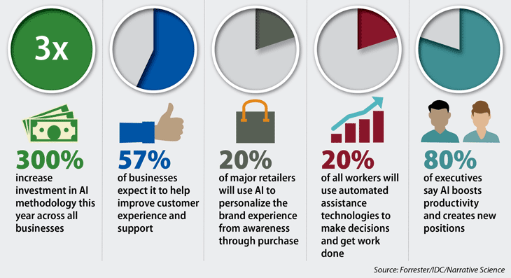
Artificial Intelligence
The Value of AI-Powered Business Intelligence illuminates the future of AI in BI
Predictive Analytics is the future generation of BI Tools
In the next 2 years, it's expected that 85% of organizations will implement AI

Slide 8
Data Mining vs Data Warehousing
It helps companies extract knowledge-based information and patterns by applying techniques such classification, regression, clustering and so on
Data mining is mining of information from data, which is new, correct and potentially useful
It also implies getting information or extracting information out of huge amounts of data
It is performed on relational databases, data warehouses or object-oriented databases
We use data mining because let us take an example, I have many emails coming in everyday, to understand which of those emails are spam alerts I can use data mining techniques
A data warehouse is used to extract all the legacy/past data and transform that data as per the business requirements and load it into a single platform or a storage space called DW on which we can perform analytical operations through OLAP by the business users
It allows business users to quickly access critical data in one place from various sources
It is also known to provide reliable information on various cross-functional activities
It is faster and is more accurate and its design is complicated
It takes a long time for data handling and size ranges from 100 GB – 1 TB+

Slide 9
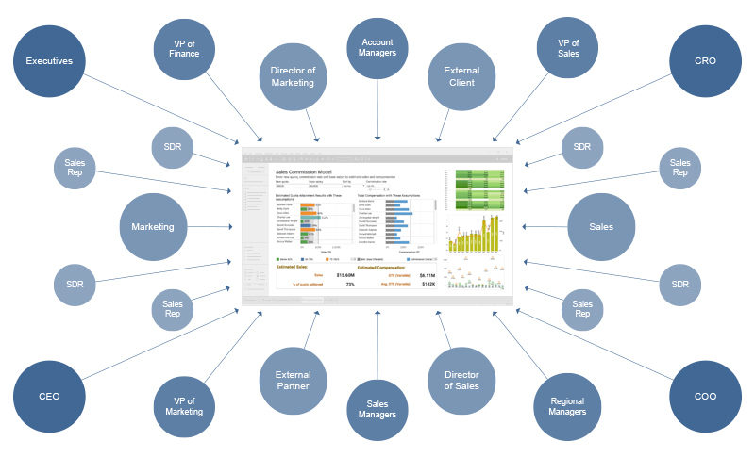
Stakeholders and Strategies
Notes:
Perform a Stakeholder Assessment
Consider Motivating Factors for Stakeholders
Set Up a Schedule and Process
Identify Allies and Adversaries
Carry Out Your Plan and Adjust Accordingly

Slide 10
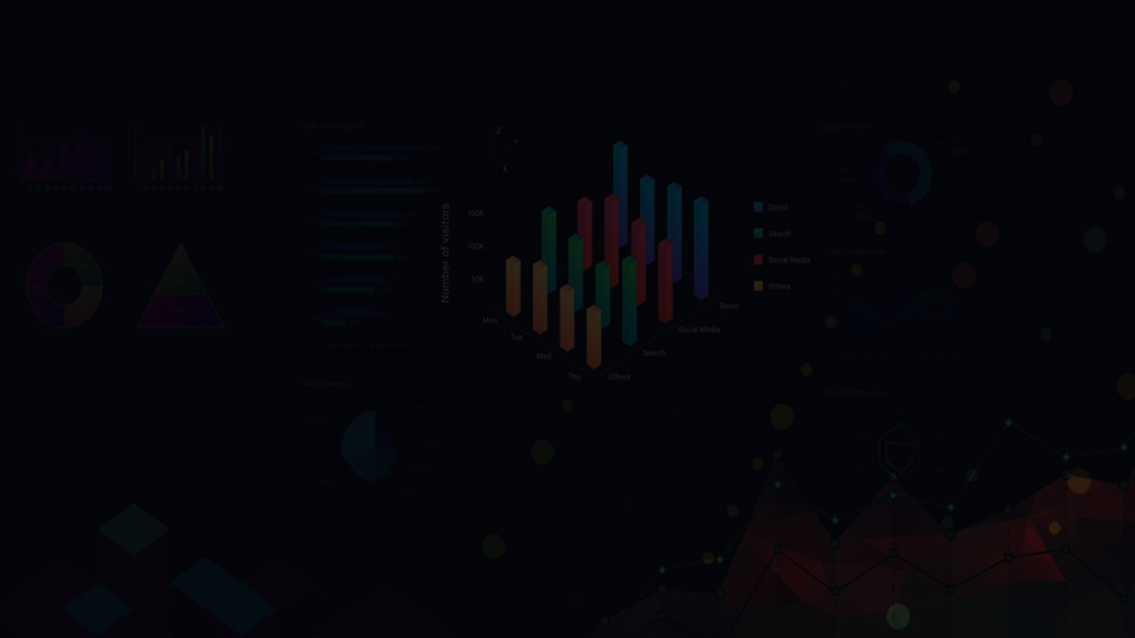
Data Visualization, Reporting, KPI’s, …
A business intelligence dashboard is an interactive visualization method for displaying various sorts of data for varying scales of corporate activities
Pick KPIs that are aligned with your strategic business objectives
Make sure the KPIs you pick are attainable
Be acute in your choice of KPIs
Analytics metrics, key performance indicators (KPIs), and other data elements that play a role in decision-making are commonly seen in BI dashboards
Pick accurate KPIs
Select KPIs that are actionable
Display KPIs that you care about

